Slide 1




Slide 2

PANEL INTERVIEW

Slide 3
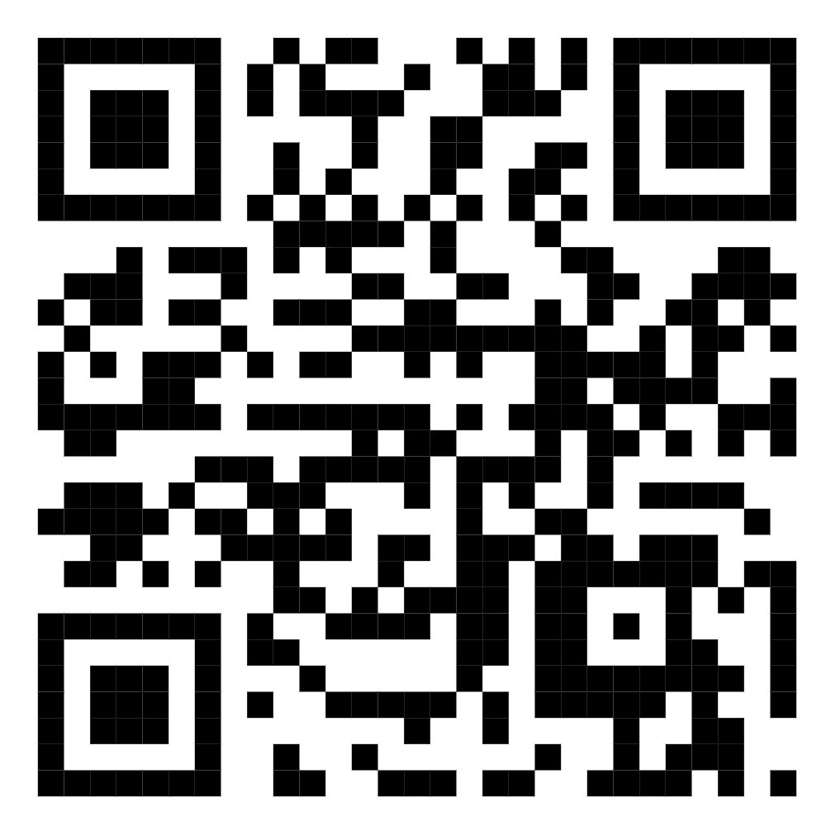
TEST TIME ON: Skype/ Telephonic interviews
QR CODE:

Slide 4

CONCEPTS
What Is A Panel Interview?
Notes:
A panel interview is a type of interview conducted by two or more interviewers. The people on the panel will be managers, peers or have important positions in the company. They could be a potential supervisor, future team member, a human resources representative, or even a manager.
During a panel interview, each panelist will ask the potential candidate a list of questions to get an idea of their talents, personalities, experience, strengths, and weaknesses to see if they fit in their company. Moreover, the interviewer could give some case study scenarios to the candidate to gauge their competency.
The company will get the desired answers at the end of the panel interview to decide if the candidate is suitable for the job. If you want to know why companies use panel interviews, continue reading below!

Slide 5

CONCEPTS
Why do companies Prefer Panel Interviews Over Personal Interviews?
Notes:
The most fundamental action to making a business become better is to choose the right person for the right position.
These are 5 reasons why companies use panel interviews instead of personal interviews:

Slide 6

CONCEPTS
Eliminating personal biases about candidates
Notes:
If the interview has only one interviewer, it will be easier to introduce one person’s bias. From there, the questions posed can further confirm the bias and derail the interview. From racial profiling to gender discrimination, an individual interviewer can be biased in so many ways. A structured interview with multiple participants minimizes the impact of biases

Slide 7

CONCEPTS
Easier organization
Notes:
A panel interview will have questions raised by the panel. This set of questions and plans can be used with all of the candidates. Therefore, it would be easier to hold structured interviews in the presence of a panel than to hold individual sessions where a candidate could get repeat questions and only one person decides whether a candidate is fit for the job or not.

Slide 8

CONCEPTS
See the potential of the candidate
Notes:
Many studies by human resources experts in the United States indicate that people can better reveal their talents under pressure. Having a candidate face multiple interviewers can help them reveal hidden strengths and weaknesses.

Slide 9

CONCEPTS
The accuracy of the interview results is improved
Notes:
Questions from multiple panelists can provide the most accurate candidate feedback, resulting in the best possible decision for their company. Together they can evaluate the candidate’s answers to identify qualifications and the suitability of the candidate for their company culture.

Slide 10

CONCEPTS
Candidates have the opportunity to understand the work and how to interact with future colleagues
Notes:
When participating in panel interviews, candidates have the opportunity to interact with employees they’ll interact with on a daily basis. In the counter-questioning part of the interview, the candidate can gain more information about what it’s like working at the company. If organized professionally and prepared, candidates have the opportunity to really understand the team dynamics and culture.
Although participating in a panel interview makes candidates face more pressure, it can also shorten the hiring time. Instead of holding a series of individual interviews, panel interviews speeds up the hiring process both candidates and employers.

Slide 11

CONCEPTS
SPEED UP YOUR HIRING PROCESS WITH BOULO SOLUTIONS
Notes:
Many companies argue that panel interviews are more effective than personal interviews because they provide a realistic experience to candidates and create a fair hiring process for all candidates. However, panel interviews require adaptability and quick thinking for the candidate and employer both, so you may struggle under interview pressure. If you’re the employer, here’s how to deal with it:

Slide 12
CONCEPTS
How To Conduct A Panel Interview?
To conduct a panel interview, the company needs a detailed plan for each interview step. You can refer to our panel interview guidelines below:
Choose interviewers for the panel.
Train the panel.
Select interview questions.
Select initial candidates for interview.
Interview candidates.
Discuss and assess candidate qualifications and if a good fit, recommend to hire.

Slide 13
CONCEPTS
Step 1: Choose the interviewers
The company can choose from 3 to 5 people to participate in the panel during the interview. The panel will include representatives who are veteran employees, peers, or managers.
Human Resources Representative
Hiring Manager
Managers related to the department that needs to hire personnel
Future team members.
Notes:
The hiring manager can act as the interview lead. The rest of the panel will act as subject matter experts (SMEs) for areas compatible with the candidate’s skills and experiences.

Slide 14

CONCEPTS
Step 2: Train the panel
Notes:
Panel members must identify what they bring to the panel in terms of their work’s focus and relevant knowledge, skills, or abilities (KSAs). Then, everyone should be on the same page on the minimum requirements candidates need to pass. Train the panel to ask open ended questions and how to form follow up questions. Most importantly, make sure they are all aware of what questions are illegal to ask such as age, pregnancy status and, in some states, current salaries.

Slide 15
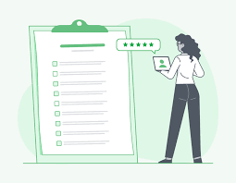
CONCEPTS
Step 3: Select interview questions
Notes:
After setting up the panel and conducting training, the interview panel members must choose appropriate questions. These questions are not the same for each panelist and should draw out the talent and experience of the candidate. By each panelist focusing on their area of expertise, the person asking the question can gauge when the answer needs further explanation.

Slide 16

CONCEPTS
Step 4: Select initial candidates for interview
Notes:
You will select the grouping of candidates based on whether their resume matches the company’s selection criteria. Narrow down the candidate pool at this stage to 3-4 candidates. Only the very best of the pool should make it to this stage.

Slide 17

CONCEPTS
Step 5: Interview candidates
Notes:
During the interview, the panel will take turns asking questions. Do not ask questions in a rush, but ask in turn and have a strategy according to the plan. In addition to asking the candidate questions to assess their experience, knowledge, and potential abilities, you must also answer the candidate’s questions about the company before the interview can end.

Slide 18

CONCEPTS
Step 6: Discuss and assess candidate qualifications and recommend to hire
Notes:
After dismissing the candidate, panel members will spend 10-15 minutes discussing and evaluating the qualifications of the candidate and making appropriate recommendations. Everyone will have their own opinion about the candidate, so someone should guide the panel towards creating an objective view to identify who best benefits the company.

Slide 19

CONCEPTS
Questions To Ask Candidates In a Panel Interview
Notes:
Asking candidates questions is the most important part of a panel interview. Knowing how to ask and organize questions will help panelists get more information about the candidates.

Slide 20
CONCEPTS
Here are some questions you should ask in a panel interview:
Tell me about yourself.
Where do you see yourself in three to five years?
What is your greatest strength?
What is your greatest weakness?
Why do you want to work here?
Why should we hire you?
Describe the best team you’ve ever worked with.
How would a colleague describe you?
How do you handle tight deadlines for projects with minimal supervision?
Imagine that you are introducing a new policy to your co-workers or employees, and you face opposition. How would you handle it?

Slide 21
CONCEPTS
Describe a time when you were working on a team project and had a conflict in the group. How did you handle the situation?
Tell us about an occasion when you had to deal with a difficult client. How did you prevent the situation from turning worse?
What is the worst mistake you made in your previous position? How did you remediate this?
Do you have any questions of your own?

Slide 22

https://learn.codemithra.com

Slide 23




THANK YOU
+91 78150 95095
codemithra@ethnus.com
www.codemithra.com

